Slide 1
CC4E: Epilogue
Dr. Charles R. Severance
www.cc4e.com
code.cc4e.com (sample code)
online.dr-chuck.com

Slide 2
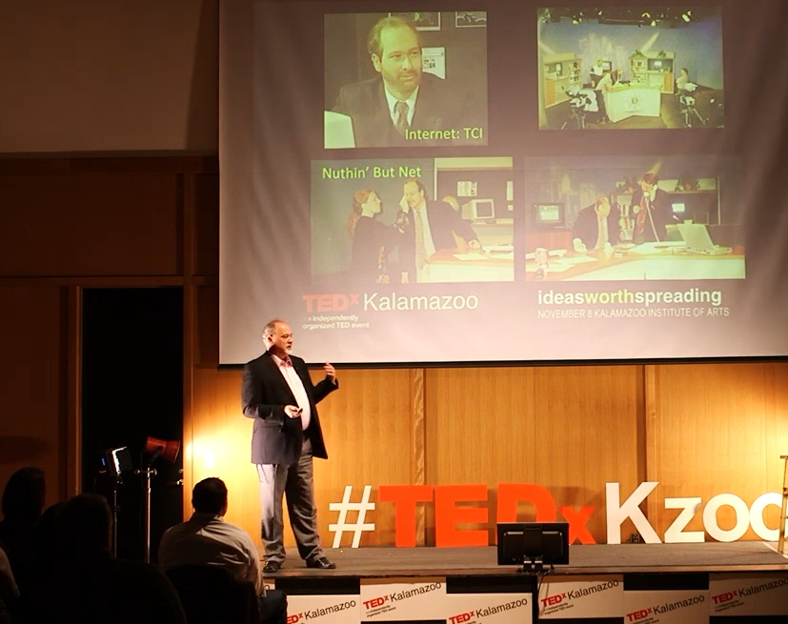
"When you think you're are finished with a journey, is often when you know where the journey actually begins.
- Dr Chuck.

Slide 3
Using K&R patterns to build Python Classes
Python String Class
  Extendable character array (not in K&R)
Python List Class
  Linked List from K&R 6.5.1 (Added by Dr. Chuck before 6.5)
Python Dictionary Class
  Hash Map of key / value pairs with buckets and linked list chains from K&R 6.6

Slide 4
Building a Python str() Class
www.cc4e.com/code epilogue / krstr.c

Slide 5
krstr_append()
length: 2
alloc: 10
data:
H e ∅ ? ? ? ? ? ? ?
int main() {
struct krstr * x = krstr_new();
krstr_append(x, 'H');
krstr_append(x, 'e');
krstr_append(x, 'l');
krstr_append(x, 'l');
krstr_append(x, 'o');
krstr_append(x, ' ');
krstr_append(x, 'w');
krstr_append(x, 'o');
krstr_append(x, 'r');
krstr_append(x, 'l');
krstr_append(x, 'd');
}
length: 9
alloc: 10
data:
H e l l o w o r ∅
realloc()
length: 11
alloc: 20
data:
d ∅ ? ? ? ? ? ? ? ?
H e l l o w o r l

Slide 6
Building a Python list() Class
www.cc4e.com/code epilogue / krlist.c

Slide 7
struct lnode {
char *text;
struct lnode *next;
};
struct krlist {
struct lnode *head;
struct lnode *tail;
int count;
};
/* Constructor - lst = list() */
struct krlist * krlist_new() {
struct krlist *p = malloc(sizeof(*p));
p->head = NULL;
p->tail = NULL;
p->count = 0;
return p;
}
text:
C
next: 0
head: 0
tail: 0
count: 0
www.cc4e.com/code epilogue / krlist.c

Slide 8
/* lst.append("Fun") */
void krlist_append(struct krlist* self, char *str) {
struct lnode *new = malloc(sizeof(*new));
new->next = NULL;
if ( self->head == NULL ) self->head = new;
if ( self->tail != NULL ) self->tail->next = new;
self->tail = new;
char *text = malloc(strlen(str)+1);
strcpy(text, str);
new->text = text;
self->count++;
}
text:
C
next:
text:
is
next: ∅
head:
tail:
count: 2
www.cc4e.com/code epilogue / krlist.c

Slide 9
/* lst.append("Fun") */
void krlist_append(struct krlist* self, char *str) {
struct lnode *new = malloc(sizeof(*new));
new->next = NULL;
if ( self->head == NULL ) self->head = new;
if ( self->tail != NULL ) self->tail->next = new;
self->tail = new;
char *text = malloc(strlen(str)+1);
strcpy(text, str);
new->text = text;
self->count++;
}
text:
C
next:
text:
is
next:
head:
tail:
text:
Fun
count: 3
next: ∅
www.cc4e.com/code epilogue / krlist.c

Slide 10
Building a Python dict() Class
www.cc4e.com/code epilogue / krdict.c

Slide 11
Dictionary
Bucket based hash map is the answer to a common programming interview question!

Slide 12
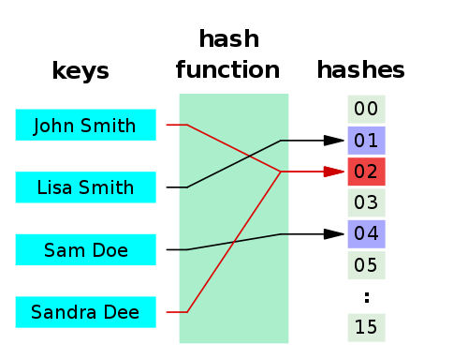
Hashes
A hash function is any algorithm or subroutine that maps large data sets to smaller data sets, called keys. For example, a single integer can serve as an index to an array (cf. associative array). The values returned by a hash function are called hash values, hash codes, hash sums, checksums, or simply hashes.
Hash functions are mostly used to accelerate table lookup or data comparison tasks such as finding items in a database...
http://en.wikipedia.org/wiki/Hash_function

Slide 13
struct dnode {
char *key;
int value;
struct dnode *next;
};
struct krdict {
int buckets;
struct dnode *heads[4];
struct dnode *tails[4];
int count;
};
struct krdict * krdict_new() {
struct krdict *p = malloc(sizeof(*p));
p->buckets = 4;
for(int i=0; i < p->buckets; i++ ) {
p->heads[i] = NULL;
p->tails[i] = NULL;
}
p->count = 0;
return p;
}
buckets: 4
∅
heads[0]
Hash % 4
∅
heads[1]
key
heads[2]
∅
heads[3]
∅
count: 0
www.cc4e.com/code epilogue / krdict.c

Slide 14
int main(void)
{
struct krdict * d = krdict_new();
krdict_put(d, "z", 8);
krdict_put(d, "z", 1);
krdict_put(d, "y", 2);
krdict_put(d, "b", 3);
krdict_put(d, "a", 4);
krdict_dump(d);
krdict_del(d);
}
buckets: 4
∅
heads[0]
Hash % 4
y=2
a=4
∅
heads[1]
key
heads[2]
z=1
b=3
∅
heads[3]
∅
count: 4

Slide 15
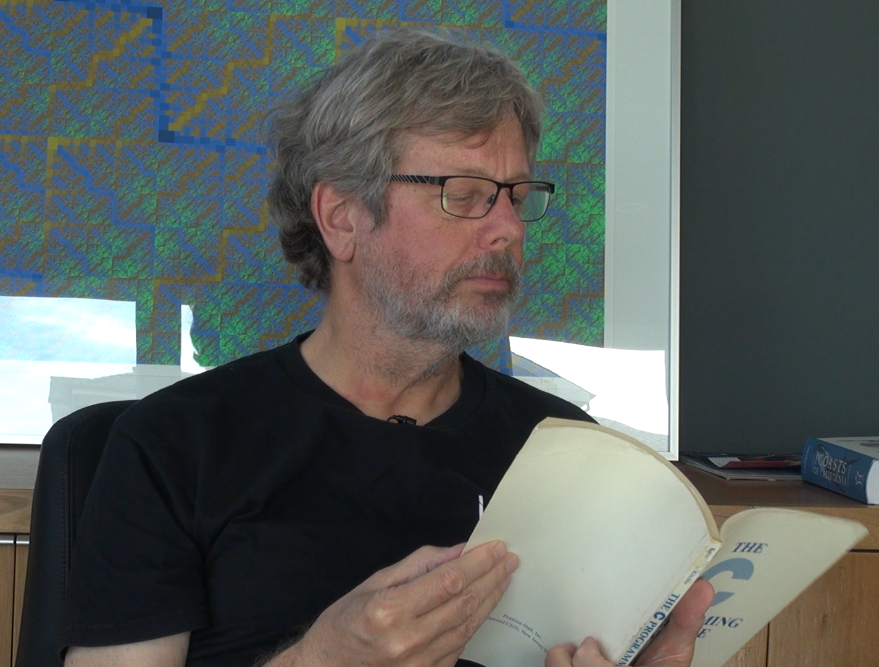
Let's visit Guido van Rossum and ask about the relationship between Python 0.0.1 and Chapter 6 of Kernighan and Ritchie…

Slide 16
"There are plenty of pointers in Python, but the classic linked list is not used much."
-- Guido van Rossum

Slide 17
Surprise!
The Python 1.0 list() and dict() objects
  Extendable arrays of pointers – not linked lists
Inspiration was not K&R Chapter 6
Inspiration for Python 0.1 dict() object
  "Collision Resolution by Open Addressing", Donald Knuth, "Sorting and Searching", pp 518-519, 1973
There were no linked lists in the core Python data structures
  Arrays turn out to have an advantage with cached memory architectures
  Efficient use of cache became increasing important in the late 1980's

Slide 18
Python 1.0 List
www.cc4e.com/code epilogue / p1list.c

Slide 19
struct p1list {
int alloc;
int length;
char **items;
};
/* Constructor - lst = list() */
struct p1list * p1list_new() {
struct p1list *p = malloc(sizeof(*p));
p->length = 0;
p->alloc = 2;
p->items = malloc(p->alloc * sizeof(char *));
return p;
}
alloc: 2
[0]
0
length: 0
[1]
0
items:
www.cc4e.com/code epilogue / p1list.c

Slide 20
/* lst.append("Hello world") */
void p1list_append(struct p1list* self, char *str) {
// Extend if necessary
if ( self->length >= self->alloc ) {
printf("Extending from %d to %d\n", self->alloc, self->alloc + 2);
self->alloc = self->alloc + 2;
self->items = (char **) realloc(self->items, (self->alloc * sizeof(char *)));
}
char *saved = malloc(strlen(str)+1);
strcpy(saved, str);
self->items[self->length] = saved;
self->length++;
}
alloc: 2
[0]
C
length: 1
[1]
0
items:
www.cc4e.com/code epilogue / p1list.c

Slide 21
/* lst.append("Hello world") */
void p1list_append(struct p1list* self, char *str) {
// Extend if necessary
if ( self->length >= self->alloc ) {
printf("Extending from %d to %d\n", self->alloc, self->alloc + 2);
self->alloc = self->alloc + 2;
self->items = (char **) realloc(self->items, (self->alloc * sizeof(char *)));
}
char *saved = malloc(strlen(str)+1);
strcpy(saved, str);
self->items[self->length] = saved;
self->length++;
}
alloc: 2
[0]
C
length: 2
[1]
is
items:
www.cc4e.com/code epilogue / p1list.c

Slide 22
/* lst.append("Hello world") */
void p1list_append(struct p1list* self, char *str) {
// Extend if necessary
if ( self->length >= self->alloc ) {
printf("Extending from %d to %d\n", self->alloc, self->alloc + 2);
self->alloc = self->alloc + 2;
self->items = (char **) realloc(self->items, (self->alloc * sizeof(char *)));
}
char *saved = malloc(strlen(str)+1);
strcpy(saved, str);
self->items[self->length] = saved;
self->length++;
}
alloc: 4
[0]
C
length: 3
[1]
is
items:
[2]
fun
www.cc4e.com/code epilogue / p1list.c
[3]
0

Slide 23
text:
C
next:
text:
is
next:
head:
tail:
text:
Fun
count: 3
next: ∅
alloc: 4
[0]
C
length: 3
[1]
is
items:
[2]
fun
www.cc4e.com/code epilogue / p1list.c
[3]
0

Slide 24
/* lst.append("Hello world") */
void p1list_append(struct p1list* self, char *str) {
// Extend if necessary
if ( self->length >= self->alloc ) {
printf("Extending from %d to %d\n", self->alloc, self->alloc + 2);
self->alloc = self->alloc + 2;
self->items = (char **) realloc(self->items, (self->alloc * sizeof(char *)));
}
char *saved = malloc(strlen(str)+1);
strcpy(saved, str);
self->items[self->length] = saved;
self->length++;
}
/* lst.append("Fun") */
void krlist_append(struct krlist* self, char *str) {
struct lnode *new = malloc(sizeof(*new));
new->next = NULL;
if ( self->head == NULL ) self->head = new;
if ( self->tail != NULL ) self->tail->next = new;
self->tail = new;
char *text = malloc(strlen(str)+1);
strcpy(text, str);
new->text = text;
self->count++;
}
www.cc4e.com/code epilogue / p1list.c

Slide 25
Python 1.0 Dictionary
www.cc4e.com/code epilogue / p1dict.c

Slide 26
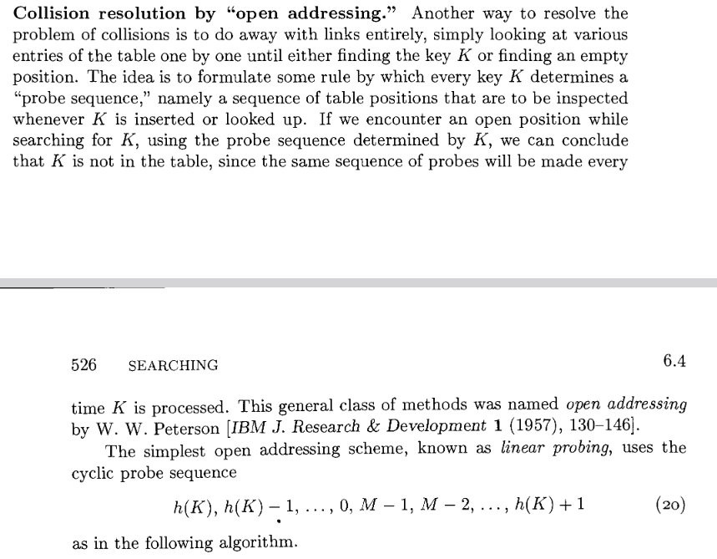
  "Collision Resolution by Open Addressing", Donald Kunth, "Sorting and Searching", pp 518-519, 1973

Slide 27
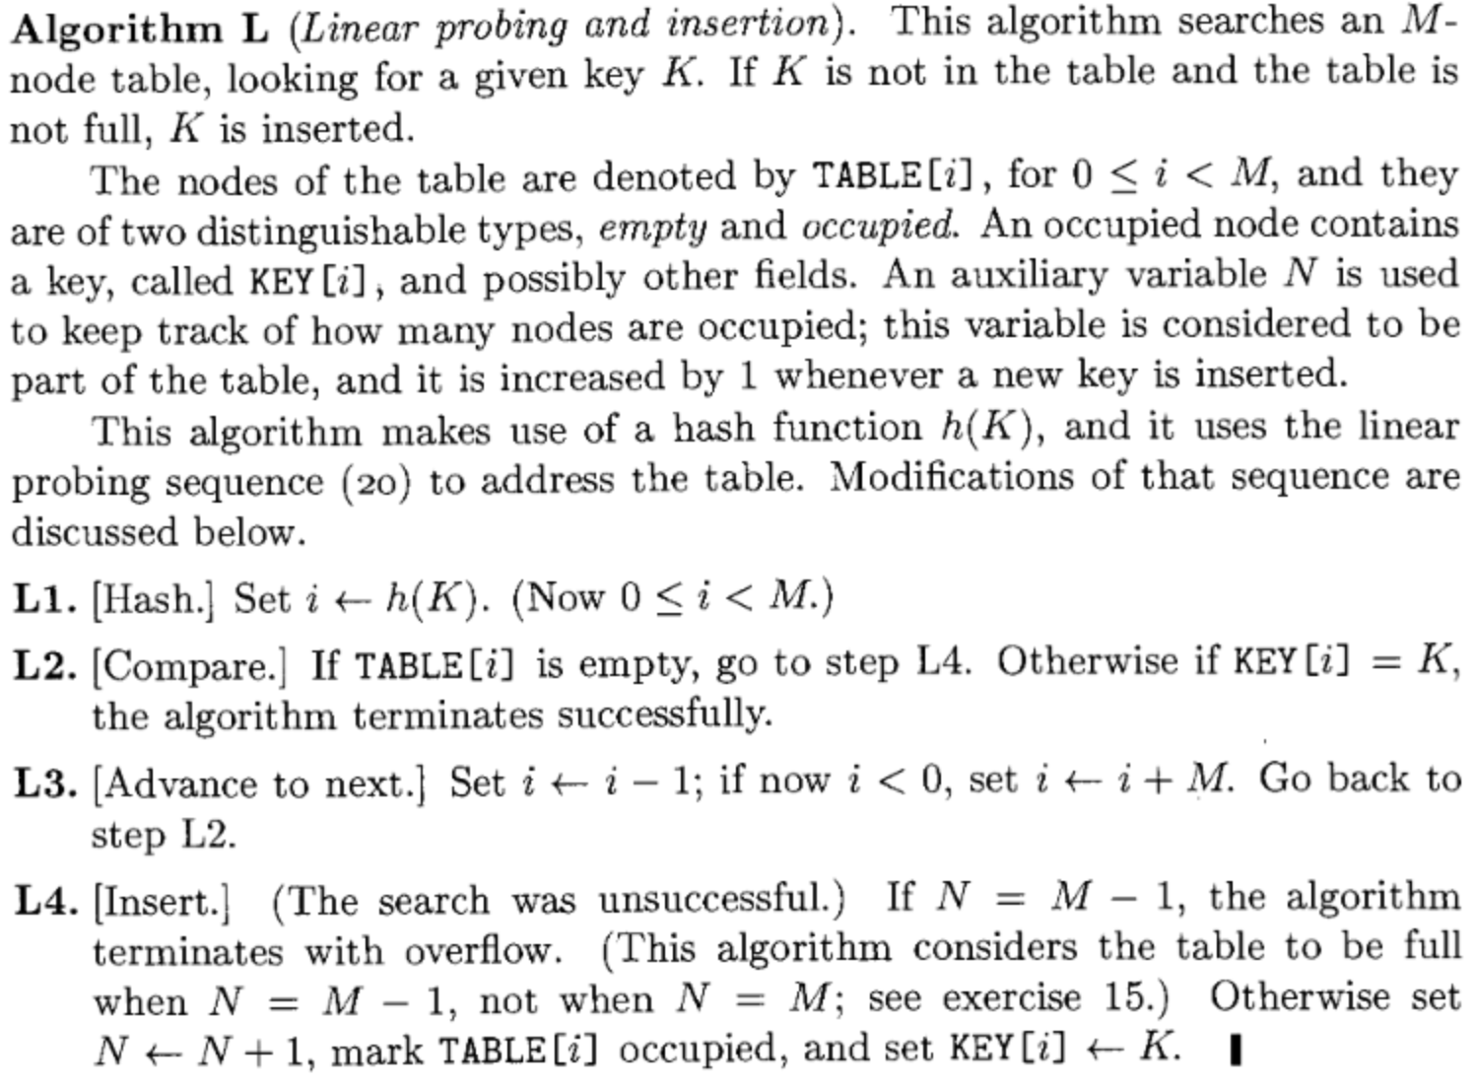
  "Collision Resolution by Open Addressing", Donald Kunth, "Sorting and Searching", pp 518-519, 1973

Slide 28
alloc: 8
[0]
key 0
value 0
length: 0
items:
Start at the position indicated by the hash and search backwards. If you reach the start of the array and have not yet found an open slot, continue at the last entry. If you come back to the original slot finding no empty entries, the map is full and must be expanded.
[1]
key 0
value 0
[2]
key 0
value 0
Hash % 8
[3]
key 0
value 0
key
[4]
key 0
value 0
[5]
key 0
value 0
[6]
key 0
value 0
  "Collision Resolution by Open Addressing", Donald Kunth, "Sorting and Searching", pp 518-519, 1973
[7]
key 0
value 0

Slide 29
struct dnode {
char *key;
char *value;
};
struct p1dict {
int alloc;
int length;
struct dnode *items;
};
/* Constructor - dct = dict() */
struct p1dict * p1dict_new() {
int i;
struct p1dict *p = malloc(sizeof(*p));
p->length = 0;
p->alloc = 2;
p->items = malloc(p->alloc * sizeof(struct dnode));
for(i=0; i < p->alloc; i++) {
p->items[i].key = NULL;
p->items[i].value = NULL;
}
return p;
}
alloc: 2
[0]
key 0
value 0
length: 0
items:
[1]
key 0
Value 0
www.cc4e.com/code epilogue / p1dict.c

Slide 30
alloc: 2
"z"
[0]
key
value
length: 1
items:
"Catch phrase"
[1]
key 0
value 0
void p1dict_put(struct p1dict* self, char *key, char *value)
{
struct dnode *old;
old = p1dict_find(self, key);
/* ... Magic happens ... */
/* Found empty slot */
old->value = malloc(strlen(value)+1);
strcpy(old->value, value);
old->key = malloc(strlen(key)+1);
strcpy(old->key, key);
self->length++;
}
Hash % 2
"z"

Slide 31
alloc: 2
"z"
Free:
[0]
key
value
length: 1
"Catch phrase"
items:
"W"
[1]
key 0
value 0
void p1dict_put(struct p1dict* self, char *key, char *value)
{
struct dnode *old;
old = p1dict_find(self, key);
/* Found Existing slot */
if ( old != NULL && old->key != NULL ) {
free(old->value);
old->value = malloc(strlen(value)+1);
strcpy(old->value, value);
return;
}
/* ... Magic Happens ... */
}
Hash % 2
"z"

Slide 32
alloc: 2
[0]
key
value
"z"
length: 2
items:
"W"
[1]
key
value
"y"
"B"
void p1dict_put(struct p1dict* self, char *key, char *value)
{
struct dnode *old;
old = p1dict_find(self, key);
/* ... Magic happens ... */
/* Found empty slot */
old->value = malloc(strlen(value)+1);
strcpy(old->value, value);
old->key = malloc(strlen(key)+1);
strcpy(old->key, key);
self->length++;
}
Hash % 2
"y"

Slide 33
alloc: 2
[0]
key
value
"z"
length: 2
items:
"W"
[1]
key
value
"y"
"B"
void p1dict_put(struct p1dict* self, char *key, char *value)
{
struct dnode *old;
old = p1dict_find(self, key);
/* ... If we need a new slot and don't find one ... */
if ( self->length >= (self->alloc*0.7) ) {
printf("We are making space for %s\n", key);
/* ... Expand / re-hash code ... */
}
}
Hash % 2
"c"

Slide 34
printf("We are making space for %s\n", key);
old_alloc = self->alloc;
old_items = self->items;
/* make new "empty items" */
self->alloc = self->alloc * 2;
self->items = malloc(self->alloc * sizeof(struct dnode));
for(i=0; i < self->alloc; i++) {
self->items[i].key = NULL;
self->items[i].value = NULL;
}
/* We need to loop through old items and re-hash them */
for(i=0; i<old_alloc; i++) {
if ( old_items[i].key == NULL ) continue;
new_item = p1dict_find(self, old_items[i].key);
new_item->key = old_items[i].key;
new_item->value = old_items[i].value;
}
free(old_items);
/* Find a space to insert in the new items */
old = p1dict_find(self, key);

Slide 35
old_items:
[0]
key
value
"z"
old_alloc: 2
"W"
[1]
key
value
"y"
alloc: 4
"B"
length: 0
items:
[0]
key 0
value 0
[1]
key 0
value 0
/* make new "empty items" */
self->alloc = self->alloc * 2;
self->items = malloc(self->alloc *
sizeof(struct dnode));
for(i=0; i < self->alloc; i++) {
self->items[i].key = NULL;
self->items[i].value = NULL;
}
[2]
key 0
value 0
[3]
key 0
value 0
Hash % 2
"c"

Slide 36
old_items:
[0]
key
value
"z"
old_alloc: 2
"W"
[1]
key
value
"y"
alloc: 4
"B"
length: 1
items:
[0]
key
value
[1]
key 0
value 0
for(i=0; i<old_alloc; i++) {
if(old_items[i].key == NULL) continue;
new_item = p1dict_find(self,
old_items[i].key);
new_item->key = old_items[i].key;
new_item->value = old_items[i].value;
}
Hash % 2
"z"
[2]
key 0
value 0
[3]
key 0
value 0
Hash % 2
"c"
www.cc4e.com/code epilogue / p1dict.c

Slide 37
old_items:
[0]
key
value
"z"
old_alloc: 2
"W"
[1]
key
value
"y"
alloc: 4
"B"
length: 2
items:
[0]
key
value
[1]
key 0
value 0
[2]
key 0
value 0
free(old_items);
[3]
key
value
Hash % 2
"c"
www.cc4e.com/code epilogue / p1dict.c

Slide 38
"z"
"W"
"y"
alloc: 4
"B"
length: 2
items:
[0]
key
value
[1]
key 0
value 0
[2]
key 0
value 0
free(old_items);
[3]
key
value
Hash % 2
"c"
www.cc4e.com/code epilogue / p1dict.c

Slide 39
alloc: 4
[0]
key
value
"z"
length: 2
"W"
[1]
key 0
value 0
"y"
items:
"B"
[2]
key
value
[3]
key
value
Hash % 2
"c"
www.cc4e.com/code epilogue / p1dict.c

Slide 40
alloc: 4
[0]
key
value
"z"
length: 2
"W"
[1]
key 0
value 0
"y"
items:
"B"
[2]
key
value
"c"
"42"
[3]
key
value
Hash % 4
"c"
if ( self->length >= (self->alloc*0.7) ) {
/* Make new "empty items" and re-hash items ... */
/* Find the location for our key in new items */
old = p1dict_find(self, key);
}
old->value = malloc(strlen(value)+1);
strcpy(old->value, value);
old->key = malloc(strlen(key)+1);
strcpy(old->key, key);
self->length++;

Slide 41
Python 3.7 Ordered Dictionary
A list() plus a hashed index with open addressing collision resolution
www.cc4e.com/code epilogue / p3dict.c

Slide 42
Recall…
Python before 3.7, dictionaries were unordered
  Because hashing ☺
As we have seen in the TreeMap exercise in CC4E, you can have more than one data structure at the same time
  Linked List + Binary Tree = Key / Value store – sorted by key
Ordered Dictionaries in Python 3.7
  Insert order (not key order!!!)
  Basically, a Python list() plus a hash index for quick lookup / get
  Iterating through 3.7 Dictionary is just like a Python 1.0 List
  Key lookup and insert is still quick

Slide 43
alloc: 4
struct dnode {
char *key;
char *value;
};
struct p3dict {
int alloc;
int length;
struct dnode *items;
int *index;
};
length: 3
items:
index:
[0]
1
[0]
key
value
"z"
[1]
-1
"W"
[2]
-1
[1]
key
value
"y"
[3]
0
"B"
[4]
2
[2]
key
value
"c"
[5]
-1
"42"
[3]
key 0
value 0
[6]
-1
Hash % 8
"c"
[7]
-1
www.cc4e.com/code epilogue / p3dict.c

Slide 44
Summary
Expandible arrays of structs with pointers to objects
Linked list is not used in Python core data structures and it was a really good choice
Moving memory management into Python and adding garbage collection instead of depending on realloc() in C was important to the success of modern Python

Slide 45
But there is more…
Python's Object Oriented Design Approaches

Slide 46
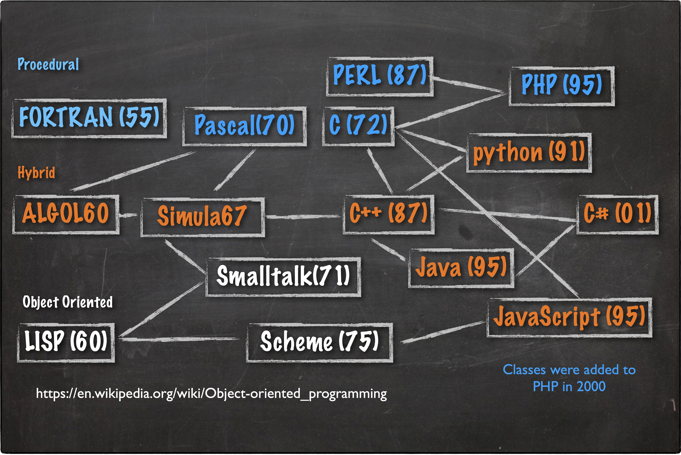

Slide 47
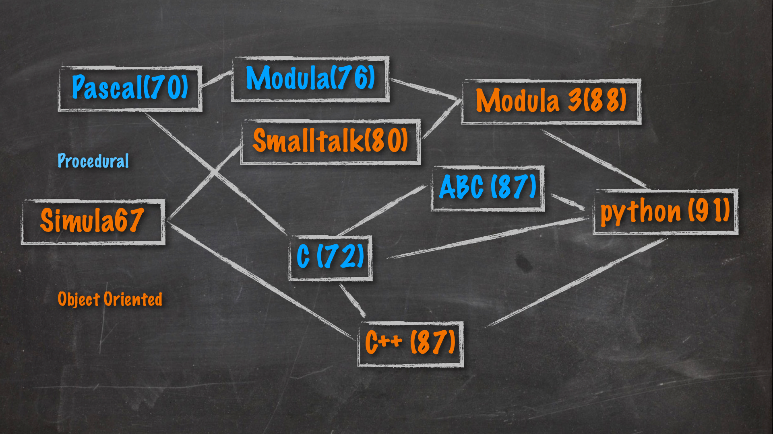

Slide 48
C++ (1972-1987)
User defined classes
Guido used and wrote code in C++
  Reference count tracking using operator overloading experiment
  Wanted to hide malloc, realloc, and from from the end-user
C++ had powerful data structures
C++ (like C) was not interested in automating management of dynamically allocated memory (i.e. simple garbage collection)
Guido chose C as the language to build Python

Slide 49
ABC (1984-1987)
Built in composable types
  Numbers
    Arbitrary length
  Text (string)
  List (sorted by value)
  Tables (sorted by key)
Used B-trees internally
Reference counting
No user defined "classes"
HOW TO RETURN words document:
PUT {} IN collection
FOR line IN document:
FOR word IN split line:
IF word not.in collection:
INSERT word IN collection
RETURN collection
https://en.wikipedia.org/wiki/ABC_(programming_language)
https://homepages.cwi.nl/~steven/abc/programmers/quick-look.html

Slide 50
From ABC to Python
HOW TO RETURN words document:
PUT {} IN collection
FOR line IN document:
FOR word IN split line:
IF word not.in collection:
INSERT word IN collection
RETURN collection
Liked the data structures available to users
Liked indentation syntax
Implementation using B-Trees was too complex
Wanted real OO
Wanted to call C libraries
Wanted lower case keywords to be more UNIX-like
def words(document):
collection = []
for line in document:
for word in line.split():
if word not in collection :
collection.append(word)
return collection

Slide 51
Modula 3 (1988)
MODULE Person;
REVEAL T = Public BRANDED
OBJECT
name: TEXT; (* These two variables *)
age: INTEGER; (* are private. *)
OVERRIDES
getAge := Age;
init := Init;
END;
PROCEDURE Age(self: T): INTEGER =
BEGIN
RETURN self.age;
END Age;
PROCEDURE Init(self: T; name: TEXT; age: INTEGER): T =
BEGIN
self.name := name;
self.age := age;
RETURN self;
END Init;
BEGIN
END Person.
Nice OO pattern
Information Hiding
Attributes
Methods
The concept of 'self' as first parameter to methods
The concept of 'self' was also present in Smalltalk-80
https://en.wikipedia.org/wiki/Modula-3

Slide 52
Let's visit Guido van Rossum again and talk about what inspired him as he was designing Object Orientation in Python.

Slide 53
Acknowledgements / Contributions
These slides are Copyright 2023- Charles R. Severance (online.dr-chuck.com) as part of www.cc4e.com and made available under a Creative Commons Attribution 4.0 License. Please maintain this last slide in all copies of the document to comply with the attribution requirements of the license. If you make a change, feel free to add your name and organization to the list of contributors on this page as you republish the materials.
Initial Development: Charles Severance, University of Michigan School of Information
Insert new Contributors and Translators here including names and dates
Continue new Contributors and Translators here

